Slide 1
Healthcare Analysis Report
An overview of healthcare metrics and insights
By: Abhishek Kulkarni

Slide 2
Contents
Introduction
Objectives
Overview
Scope
Data Exploration And Cleaning
Data Modelling
Dashboards
Conclusion

Slide 3
Introduction
In today's rapidly evolving healthcare landscape, data-driven decision-making is crucial for improving patient care, optimizing resources, and ensuring financial sustainability. The Healthcare Analysis Dashboard serves as a powerful tool that consolidates critical healthcare data into an interactive and visually appealing format.
This dashboard provides a holistic view of healthcare performance by integrating multiple data points, such as patient volume, treatment distribution, financial metrics, and patient satisfaction scores. By analyzing trends and key performance indicators (KPIs), healthcare providers and administrators can make informed decisions that enhance operational efficiency, improve patient outcomes, and optimize resource allocation.

Slide 4
Objectives
To provide a comprehensive and data-driven approach to monitoring healthcare performance by analyzing patient volume, treatment distribution, service utilization, financial metrics, and patient satisfaction.
It aims to track patient visits, evaluate the efficiency of different departments and procedures, assess revenue generation from treatments, and analyze insurance coverage trends.
Additionally, the dashboard helps in identifying diagnosis patterns, optimizing resource allocation, and improving patient experience through enhanced satisfaction tracking.
By leveraging these insights, healthcare administrators, practitioners, and policymakers can make informed decisions to enhance operational efficiency, patient care, and financial sustainability.

Slide 5
Overview
Data analysis plays a critical role in healthcare analysis by transforming raw medical data into actionable insights that enhance patient care, operational efficiency, and financial performance.
It helps healthcare providers track patient volumes, treatment effectiveness, insurance claims, and cost distribution, enabling better resource allocation and strategic planning.
Predictive analytics assist in early disease detection, risk assessment, and outbreak prevention, improving clinical outcomes.
Additionally, patient satisfaction analysis helps refine service quality and engagement strategies.
By leveraging real-time data, AI, and machine learning, healthcare analysis becomes more efficient, proactive, and patient-centric.

Slide 6
Project Scope
The scope of data analysis in healthcare analysis is vast, enabling better decision-making, operational efficiency, and improved patient outcomes.
It aids in real-time patient monitoring, disease prediction, resource optimization, and cost reduction.
Financial analytics help manage revenue, insurance claims, and fraud detection, while predictive models assist in early diagnosis and outbreak prevention.
Additionally, patient satisfaction analysis enhances service quality and engagement. With advancements in AI, machine learning, and big data, healthcare is becoming more data-driven, proactive, and patient-centric.

Slide 7
Data Exploration & Cleaning
Data Exploration & Cleaning:
The analysis is based on 8 CSV files, which are cleaned and manipulated to extract valuable insights.
Identify missing and duplicate values in each data set and treat them accordingly.
Also treat all data quality issues associated with the dataset.

Slide 8
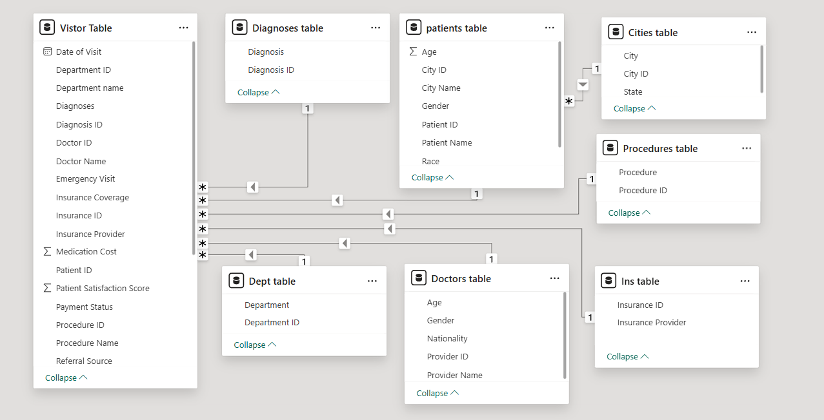
Data Modelling

Slide 9
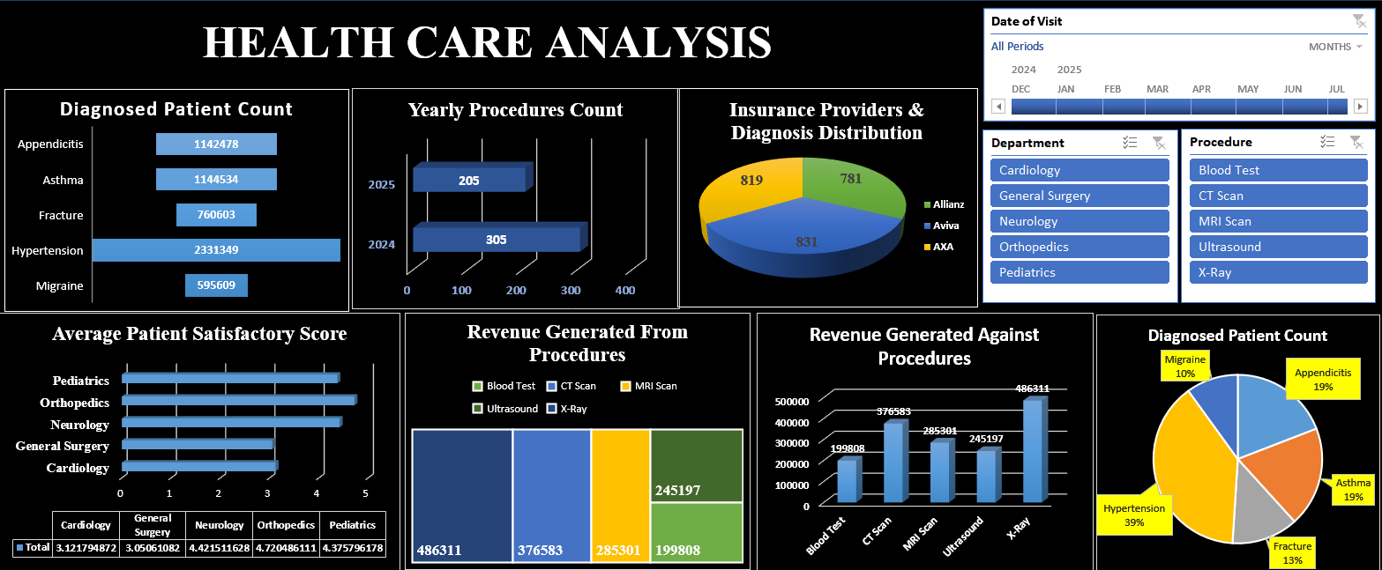
Excel Dashboard

Slide 10
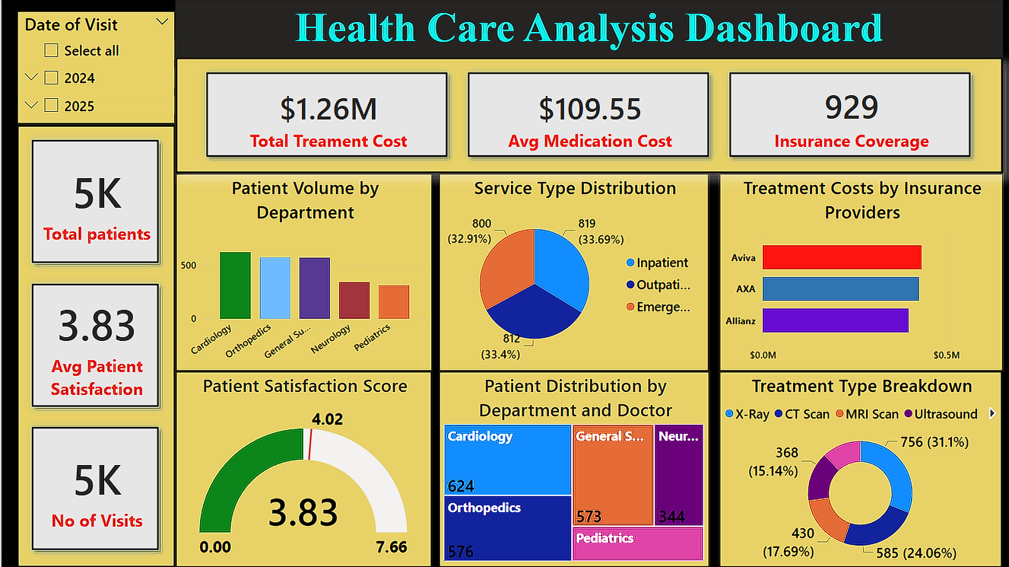
PowerBI Dashboard

Slide 11
Conclusion
The healthcare analysis reveals valuable insights into patient volume, service distribution, financial performance, and diagnosis trends. The total number of patients recorded is 5K, with an average patient satisfaction score of 3.83. Among departments, Cardiology and Orthopedics have the highest patient volume, while Orthopedics and Pediatrics lead in patient satisfaction.
Service and treatment distribution show a balanced mix of inpatient, outpatient, and emergency services. Among medical procedures, X-Rays and MRI scans are the most frequently conducted, significantly contributing to overall revenue. CT Scans and Ultrasounds also play a vital role in service utilization.
Financially, X-Rays and CT Scans generate the highest revenue, followed by MRI scans and ultrasounds. Insurance providers such as Aviva, AXA, and Allianz cover major treatment costs, with Allianz having the highest contribution.
Regarding diagnosed conditions, Hypertension (39%) is the most common, followed by Appendicitis (19%), Asthma (19%), Fractures (13%), and Migraines (10%). These trends provide critical insights for resource allocation, patient care improvement, and financial planning in the healthcare sector.

